Slide 1


2025 TSC Annual Declaration
Summary of Results

Slide 2
2025 TSC Annual Declaration
The TSC has 12 commitments covering economic, visitor, community and environmental sustainability. It has been signed by over 2000 businesses
Each year all signatories are requested to complete an annual declaration so that progress against these commitments can be monitored.
This report reflects the current state of progress by respondents in advancing the Tourism Sustainability Commitment’s twelve Commitments.
This is the fourth such survey of TSC signatories, run since the disruption caused by the COVID-19 pandemic.
Data from this survey will build on our knowledge for on-going tracking of TSC progress.

Slide 3
Methodology
Run using Survey Monkey in September – October 2024
Questions based on the 12 commitments of the NZ Tourism Sustainability Commitment
622 responses from all regions of NZ (29% of signatories)
39% from accommodation & hospitality sector, 25% from Adventure & Outdoor, 21% from tourism services, 13% from attractions, conferences & events, 10% ITOs or travel agents
506 (81%) TIA members and 116 (19%) non-members

Slide 4
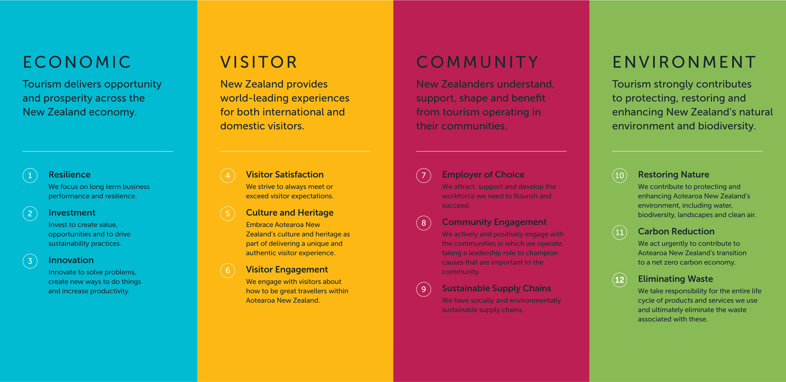
The NZ Tourism Sustainability Commitment

Slide 5
Executive Summary - Key Insights
Businesses will prioritise sustainability to meet customer expectations and improve profitability
The top barriers to progress are a lack of time and resources
98% of respondents recognise sustainability as important to their business
Overall business confidence has declined in the last 3 years
Increasing numbers of business are measuring their carbon footprint, but fewer are getting certification.
Most businesses are confident of attracting and retaining the staff they need, offering a wide range of staff benefits
Many businesses are not yet proactively encouraging visitors to be good travellers by sharing the Tiaki Promise
Most businesses (73%) said they had been impacted by changing weather patterns
Most businesses are contributing to Predator Free 2050 by building actions into their business plans

Slide 6


Sustainability Progress
As in previous years there is a big discrepancy between sustainability aspirations and actions.
However, there is a slight increase in the number of operators with sustainability metrics, plans and a budget.
2024 | 99% | 53% | 43% | 18%
2025 | 98% | 55% | 48% | 22%
 | say sustainability is important to their business | include sustainability metrics in reporting | have a sustainability plan | have a sustainability budget

Slide 7
Score by Commitment 2025
Average Score is 8.1
There are some small variations between commitments, but the overall average has remained extremely similar for 4 years.
  2022 avg score = 8.06
  2025 avg score = 8.13
This indicates stability across many areas reflecting a level of maturity in systems and processes.

Slide 8
Commitments with the most significant changes
Compare 2025 to 2022:
Resilience (business confidence) scored comparatively high in 2022 and has declined from 9.0 to 8.4
Being an employer of choice has increased from 6.8 to 7.6
Carbon reduction has increased from 4.5 to 5.3

Slide 9
Businesses are taking a purposeful approach to sustainability
Select the statements which align with your business operations.

Slide 10
Motivation
For 39% sustainability is already a top priority
For the others a stronger business case needs to be made to drive sustainability actions
Businesses will prioritise sustainability to meet customer expectations and improve profitability.
We struggle to know what sustainability initiatives to implement
Government investment in sustainability, rather than fast-tracking non-sustainable initiatives.
Hearing from customers that sustainability is an important motivator in choosing where to stay

Slide 11
Barriers
Time and financial constraints continue to be significant barriers to progress.
43% say nothing is holding them back from making progress towards sustainability goals
Government and local councils are way behind in providing the infrastructure to enable further improvement.
Infrastructure within NZ is part of the Sustainability is always front of mind however it’s knowing what really makes a difference ie where to focus on the changes reason.
We want to bring in Hybrid/electric buses but we can't due to the law and there is no subsidy.
We are progressing but not as quickly as initially thought.

Slide 12
Support
Businesses prioritize online information, tools, and resources (46%) as the most desired support to accelerate their sustainability actions.
Access to funding to achieve our next steps
Tax incentives

Slide 13
Commitment 1: Resilience
86% of businesses feel confident about their future, which is a very slight improvement on last years’ results (84%).
Only 38% of businesses are "very confident" about their future, a significant drop from 60% reported in 2022.
Data from the latest 2025 Workforce Survey very closely aligns with these results: 86% of businesses reported feeling at least “somewhat optimistic” about the 12 months ahead, up 11% on 2024.
Notes:
Workforce Survey
75% feel very optimistic, optimistic or somewhat optimistic about the future of their business
Only 15% feel very optimistic about their future.
The questions were asked slightly differently but I think it is still interesting to compare:
In the workforce survey only 15% feel very optimistic about their future, compared with 37% of businesses saying they felt very confident about the future of their business in the TSC declaration.
Even if we group the responses, 75% of the workforce respondents report feeling (very or somewhat) optimistic compared to 84% of TSC respondents feeling (very or quite) confident about their future.
This is such a big difference that I think we can say that businesses who are focussing on sustainability are feeling better about their future.

Slide 14
What are your biggest concerns regarding the future resilience of your business?
LEADING CONCERNS: Financial pressures, changing customer patterns, extreme weather events
LOWER PRIORITIES: Digital trends, health & wellbeing
NOTABLE CONCERNS: Staffing issues, policy changes, natural hazards
73% said their business had been impacted by changing weather patterns.
Global health, political and financial events
International instability leading to drastic visitor market changes over short periods of time.
The last two years have been the worst ever in the last three decades!!!
DOC and Iwi making changes to concessions
Cyber security

Slide 15
Commitment 4: Visitor Satisfaction
While nearly all businesses measure customer satisfaction levels, not all business owners always act on customer feedback.

Slide 16
Commitment 5: Culture & Heritage
Our unique point of difference is not yet being fully embedded in the experiences we offer our visitors.
There is room to improve how we embrace and share the cultural aspects of the visitor experience.

Slide 17
Commitment 6: Visitor Engagement
Embedding the Tiaki Promise is one of the 10 actions in the Tourism 2050 Blueprint
However many businesses are not yet proactively encouraging visitors to be good travellers by always sharing the Tiaki Promise

Slide 18
Commitment 7: Employer of Choice
62% are extremely or very confident that they can attract and retain the staff they need.
This is a slight increase on last year (59%)

Slide 19
Commitment 8: Community Engagement
Commitment 9: Sustainable Supply Chains
Most businesses (80%) engage with their local community either "always" (48%) or "usually" (32%) to create mutual benefits and 54% have a plan to guide this work.
Many respondents always (25%) or usually (49%) work with suppliers to ensure that their purchases are the most sustainable options available. However for a quarter of respondents this is not a common consideration.
Buying local is strongly favoured by tourism operators where possible, with a majority (83%) always or usually sourcing local products.

Slide 20
Commitment 10: Restoring Nature
92% of respondents always or usually consider the impact of their actions on the environment.
32% are NOT supporting any predator-free programmes.
Our guests have the opportunity to "Go Green" which involves opting out of room servicing. A portion of the money saved from labour costs here goes to our Sustainability Fund.
We have planted several thousand trees on our and neighbouring sections. We are seeing more and more native birds. Guests love seeing kereru and pukeko in particular.
We have our own conservation project and a charitable trust set up to assist with this work

Slide 21
Commitment 11: Carbon Reduction
Businesses are progressing on their carbon reduction journeys at different paces depending on their resourcing and needs.
53% have not yet taken concrete steps forward in measuring their emissions. This is a slight improvement on last year (51%).
A wide range of tools are used to measure carbon emissions – this is a very fragmented market! The most popular tools used are Toitu and Ekos with 15% each.
Some expressed dissatisfaction with certification schemes, opting instead for more direct action, such as supporting local conservation efforts.
We don't measure carbon, and have no plans to, but we may well be close to zero-carbon or better.
We are focusing on reducing our emissions vs just off setting be seen as zero carbon.
Investing in solar for the entire operation of the business in 2026

Slide 22
Carbon Measurement vs Certification
Measuring
Certifying
47% in 2025
MORE
respondents are measuring their carbon emissions.
FEWER respondents are getting zero carbon certification.
13% in 2022
29% in 2022
5% in 2025
The percentage of businesses measuring emissions continues to grow,
while the number getting certification is declining.
Notes:
Remember that this is the percentage of RESPONDENTS not of the whole sector!
Getting certification comes at a cost but many consumers do not understand what the certification means.
So businesses are choosing to spend this money on mitigating emissions rather than certification.

Slide 23
Commitment 12: Waste Elimination
Over half the respondents (53%) have completed a waste audit of their business.
A majority of respondents (87%) always or usually manage their waste to minimise what gets sent to landfill.
There is a slight increase in the number reporting that they never work to minimise waste sent to landfill (3% up from 1% last year).
We use no single use plastic in anything we supply on tours
We have 9 compost bins and bury any fats etc to help fertilize our garden. We recycle everything which is accepted

Slide 24
Some Further Comments
As a seasonal business and as we go through the waves it is incredibly hard to find any downtime to complete projects.
We are a not-for-profit, purpose-driven entity where all we do is centred around restoring and enhancing New Zealand’s native flora and fauna.
Fuel - aviation and land based remains the largest challenge in tourism
We are always looking to improve our processes and practices as it is simply following good business practices and is the right thing to do.
Very difficult in the holiday park setting, guests are not good at recycling, and more than half can't be bothered making any significant effort
We work hard at our commitment to reducing waste and recycling. Our biggest challenge continues to be sourcing suppliers who have the same goal.
We find that this falls down the list of responsibilities as it is no one’s specific role. A group has been established and we hope this will slowly build understanding and better decision making.
We very much believe that we are on a sustainability journey - it has highs and lows - and constant challenges, but we continue to learn and improve and are always seeking betterment of our business in this area.
Just upgraded our compost and worm farm. Working at ticking off more things on our action plan from the Green Room.
Really appreciate TIA’s support and the TSC, Thank you.

